Slide 1




Isabel.
Camilio.
Nicole.
Diabetes
In the U.S.A.
Taking a look at the data.

Slide 2




Project Overview
How does change in insulin price compare to change in GDP?
In California, how does diabetes prevalence change over time?
In California, does a particular race have more diabetes than others?
Is California an outlier compared to other states in regard to diabetes prevalence?
Are diabetes deaths correlated with poverty, GDP, population, or employment?

Slide 3




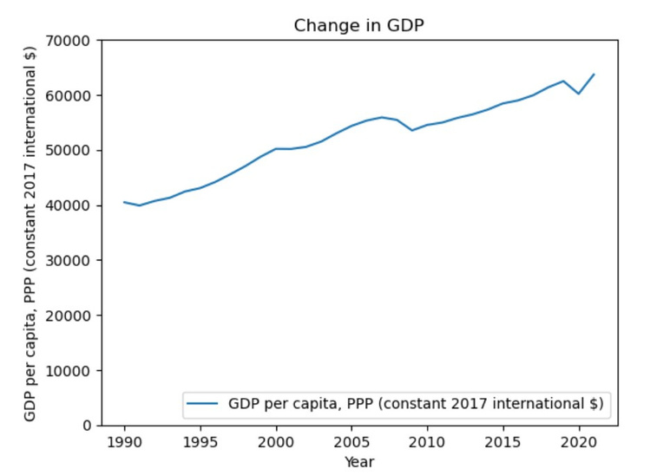
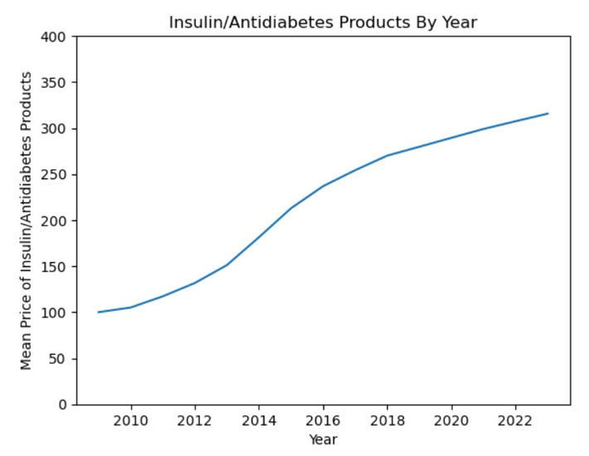
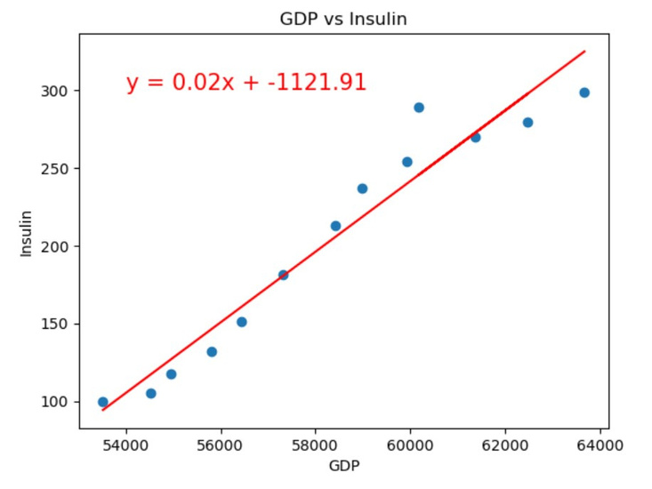
Insulin Price
vs. GDP
GDP per Capita has increased
from 1990 to 2021
Prices of insulin/antidiabetic products have increased
from 2009 to 2023
Strong correlation between
GDP and insulin prices
2009 - 2021

Slide 4
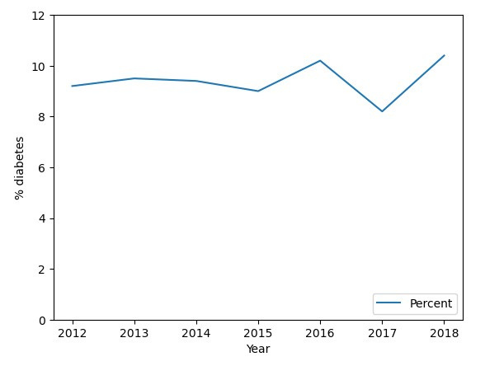

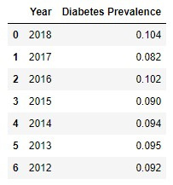

How does California diabetes prevalence change overtime?
1.2 % increase.
2012: 3,499,812
2018: 4,113,933

Slide 5
Results
How does change in insulin price compare to change in GDP?
The average insulin price in 2009 was $100 and in 2023, the average insulin price was $315. GDP was $40,456 in 1990 and jumped to $63,669 by 2021. There is a strong, positive correlation between GDP per capita and price of insulin.
In California, how does diabetes prevalence change over time?
There has been a 1.2% increase in diabetes between 2012 and 2018. In 2012, there were 3,499,812 residents with diabetes and 5 years later in 2018 there were 4,113,933 people with diabetes. This is 614,121 more people with diabetes between 2012 to 2018.

Slide 6
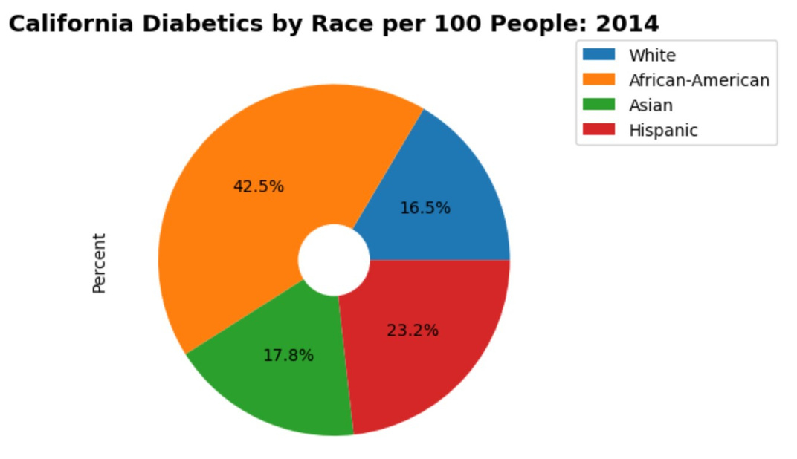
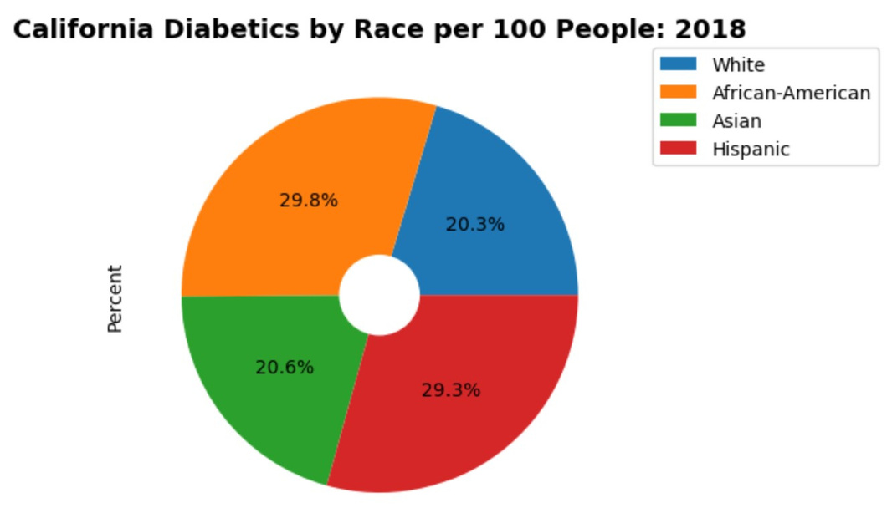
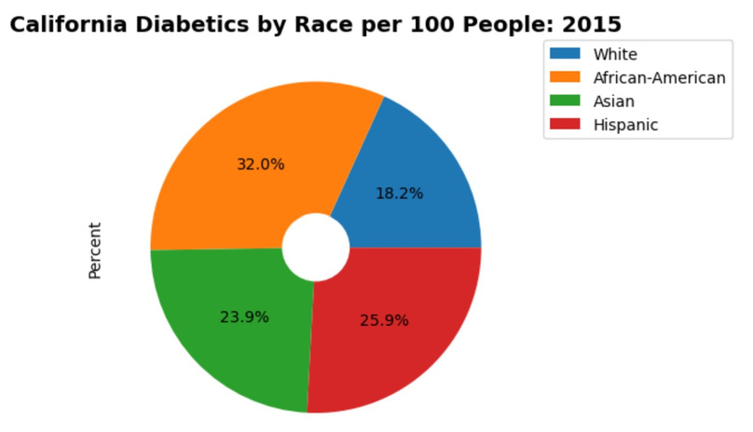
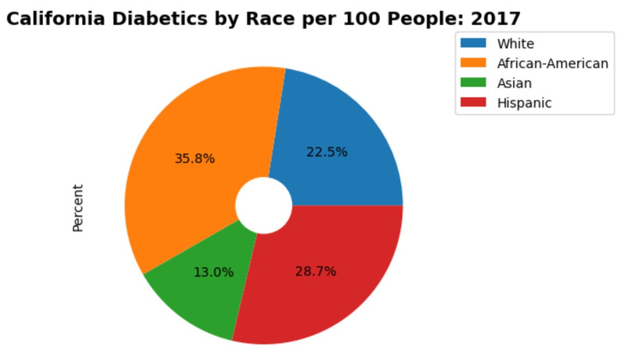
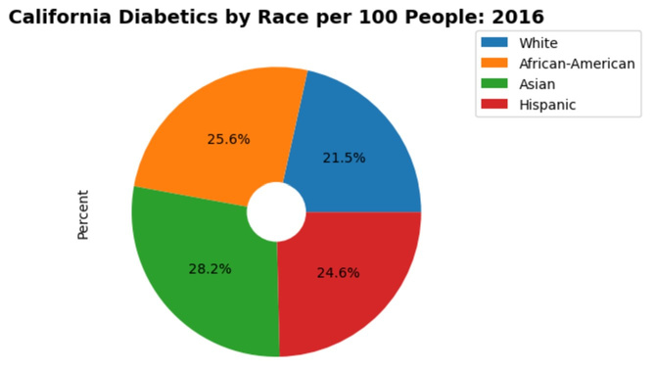
California
Pie Charts:
Per year,
By Race

Slide 7
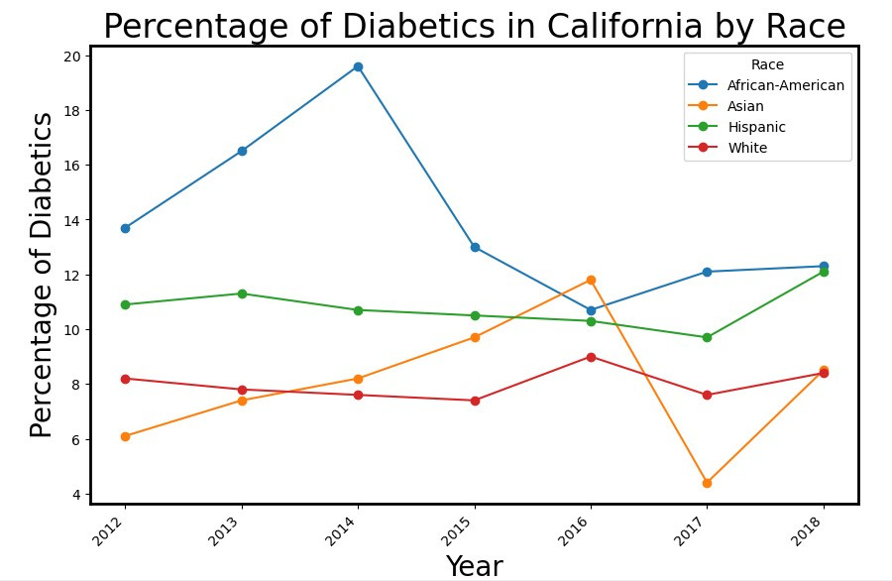
In California, does a particular race have more diabetes than others?

Slide 8

Results
In California, does a particular race have more diabetes than others?
From 2014 to 2018 there was a significant change in the amount of African-Americans with type 2 diabetes compared to other races. From 42 percent down to 29 percent. Not only African-Americans, but Asian-Americans had a wave of diabetes getting from 28 percent of the population down to a low 13 percent, and then back up to 20 percent. Based on the trend it seems like each race has almost hit equal levels of diabetes. In California there are numerous programs such as the "Diabetes Prevention Porgram" that encourages lifestyle changes to Medi-Cal patients to prevent or delay type 2 diabetes.

Slide 9
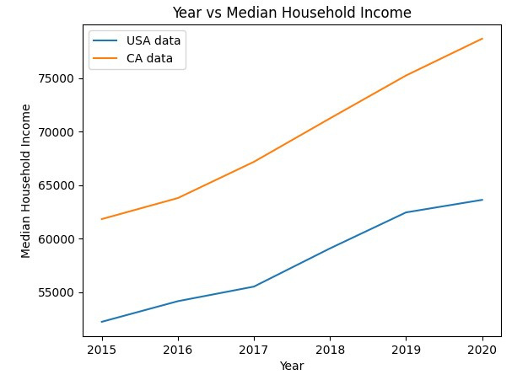
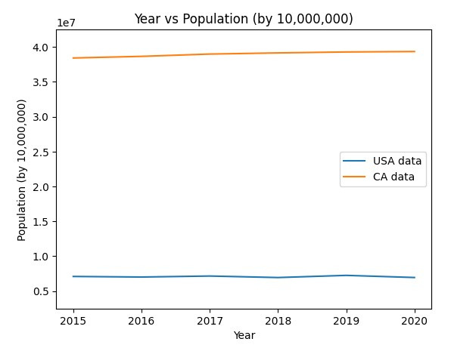
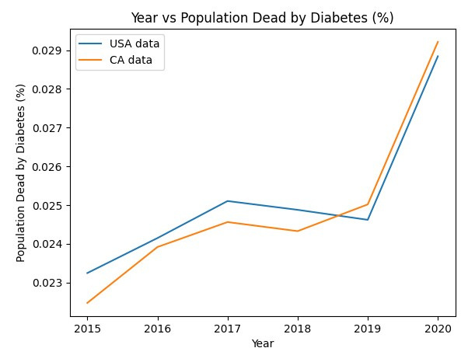
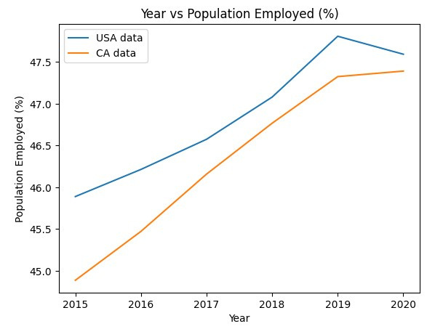

California vs.
USA
NOTE: USA Data is based on the average for all states in that year
similar
percentage of population dead by diabetes
percentage of population in poverty
different
higher population
higher median household income
lower percentage of population employed

Slide 10
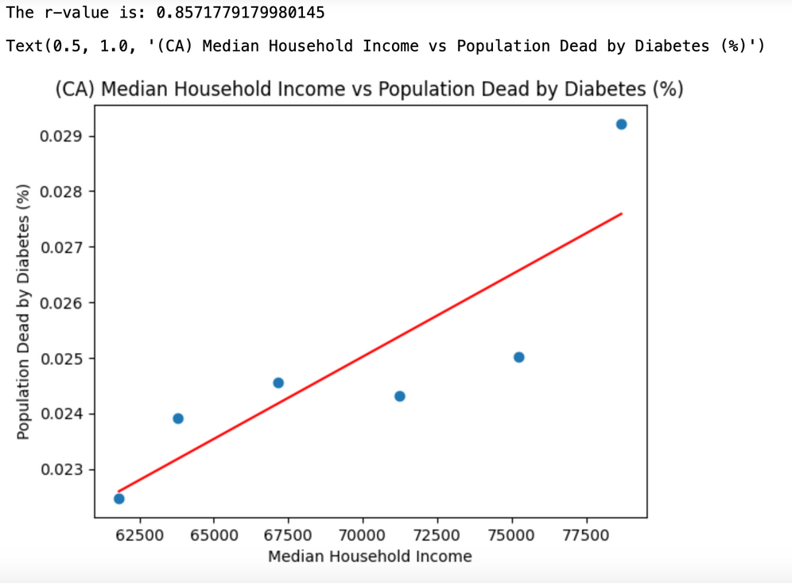
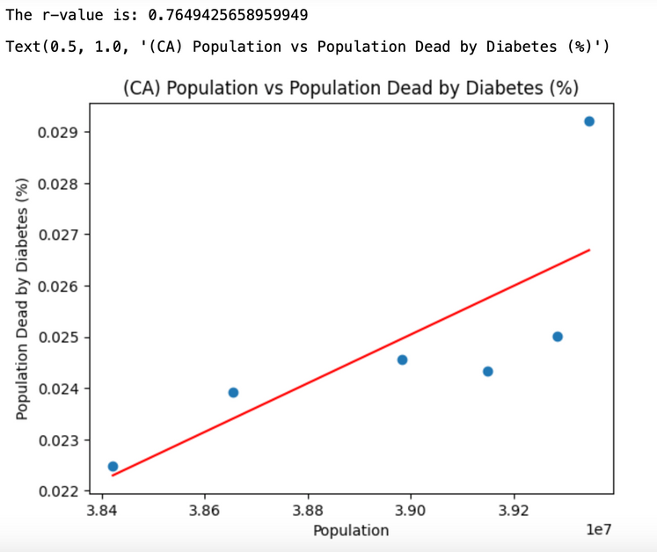

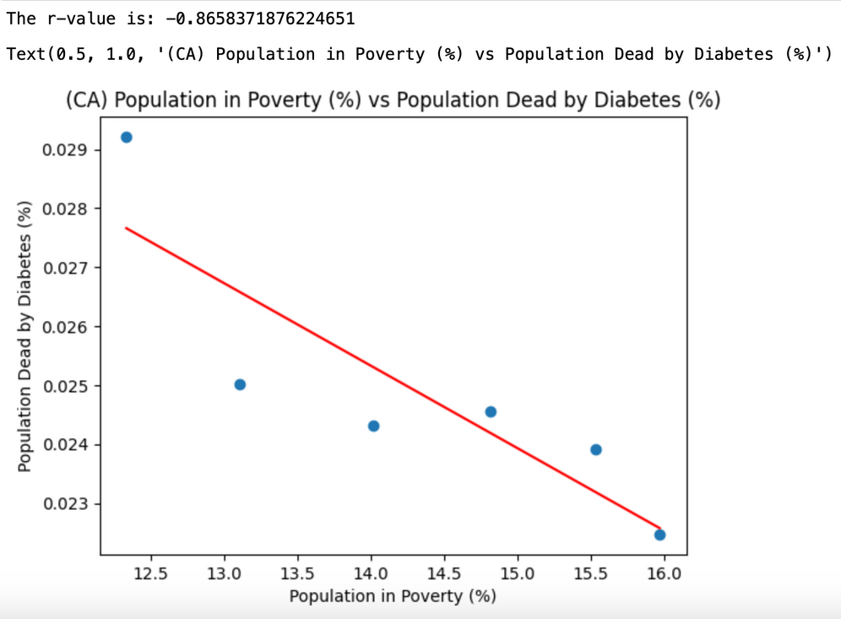
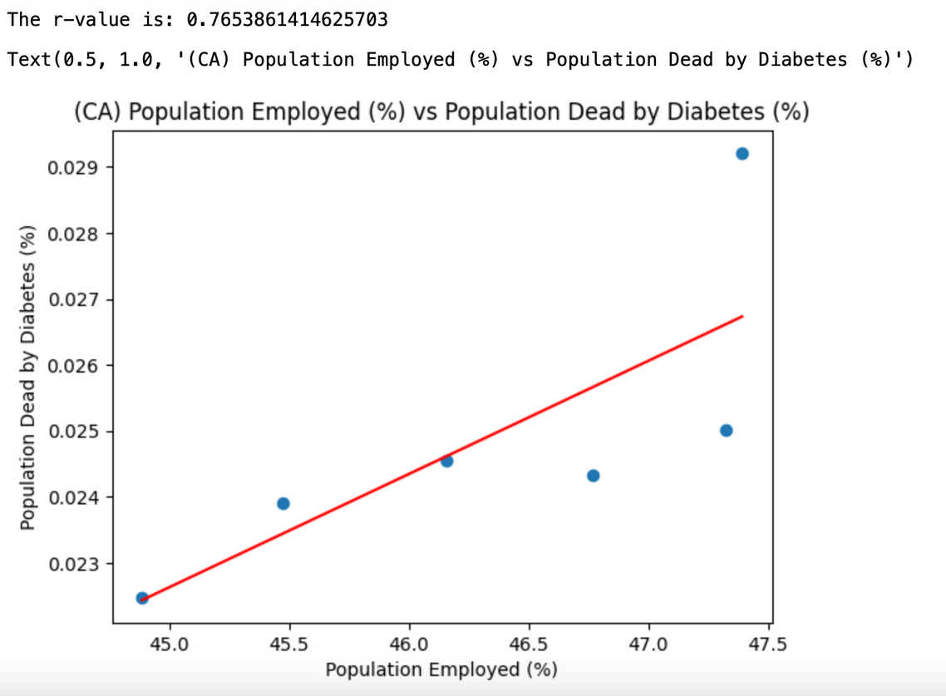
California
all have a strong linear correlation
unexpected results:
negative correlation:
population in poverty
positive correlation:
median household income
population employed

Slide 11
Project
Potential Causes
median household income and population employed are increasing over time
Target/Result # 1
Briefly explain the statistic.

Slide 12
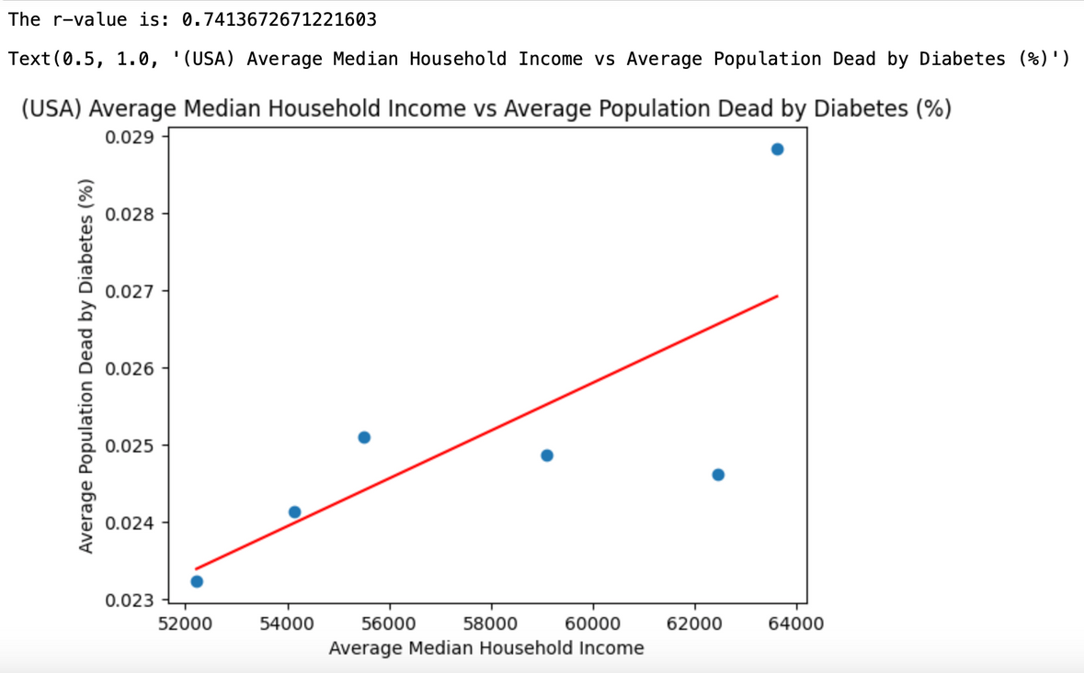
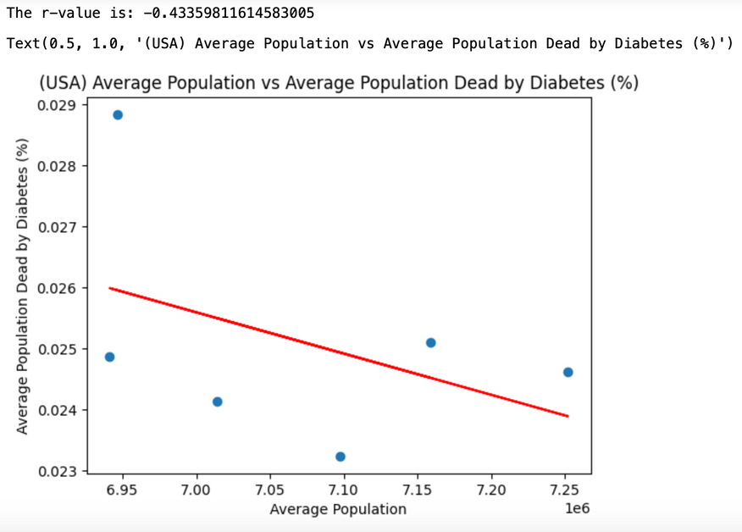
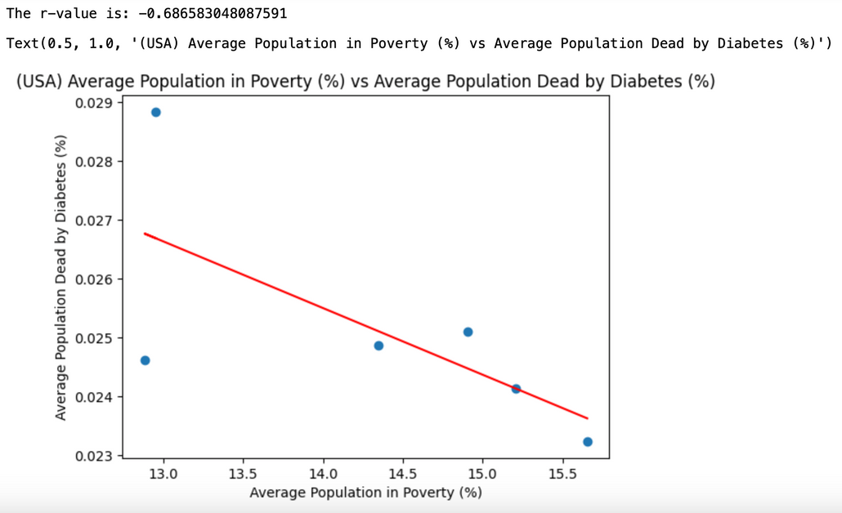
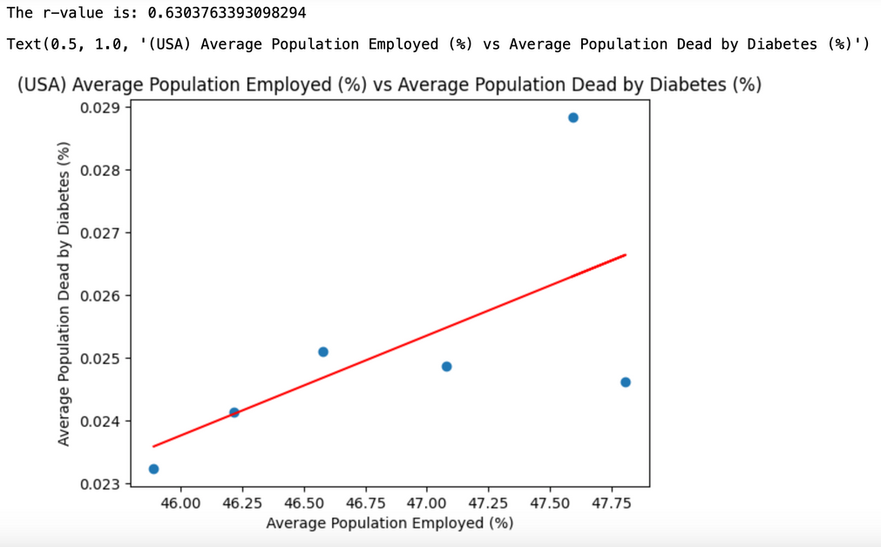

USA
NOTE: USA Data is based on the average for all states in that year
see a similar situation as in CA
average population has negative correlation
linear correlations are less strong

Slide 13
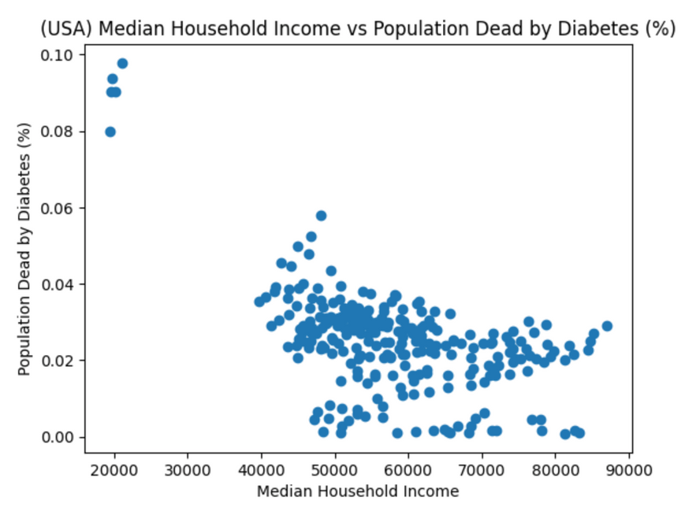
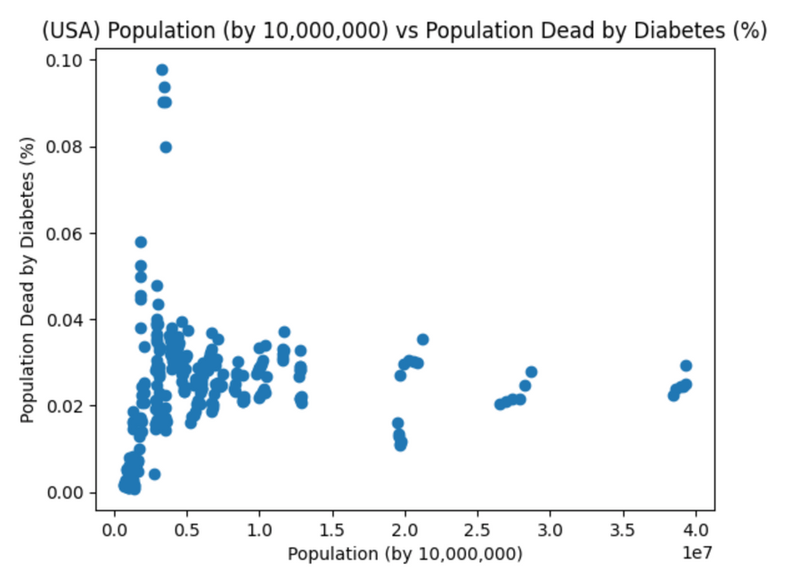
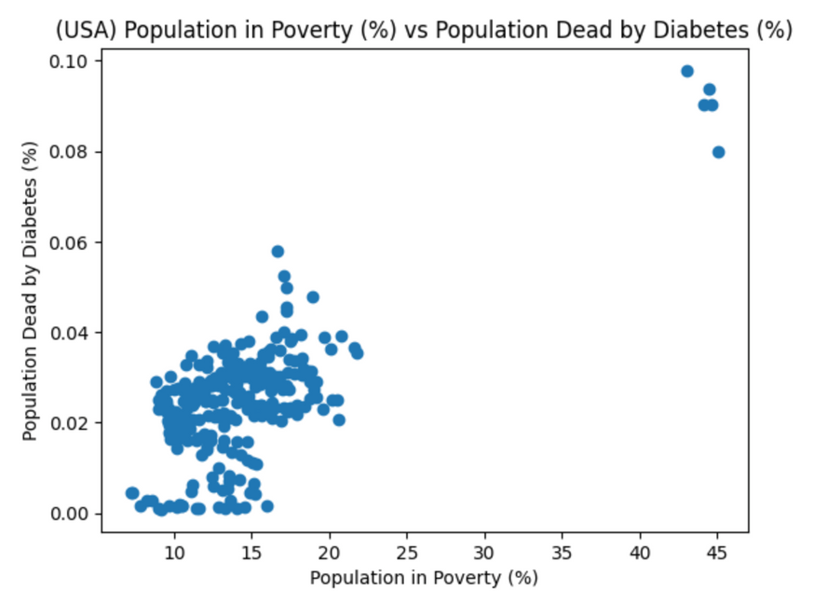
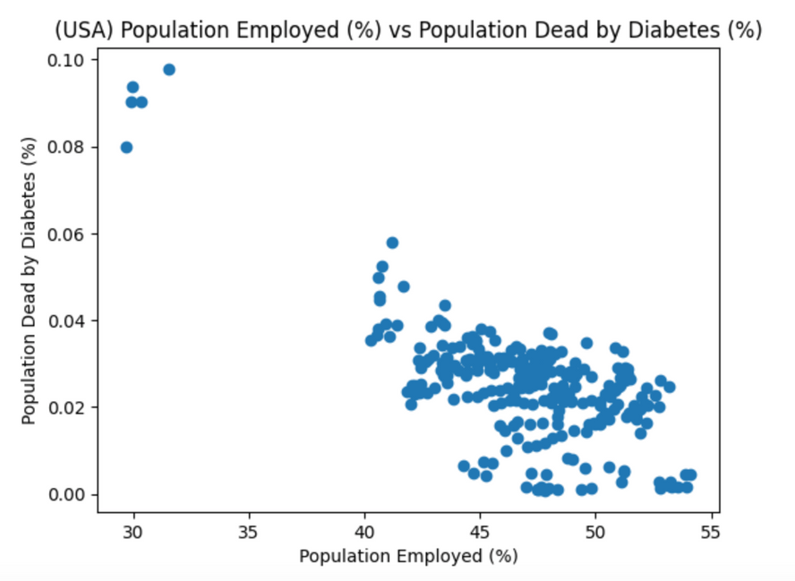
USA
cluster of points seperated from the rest
Puerto Rico

Slide 14
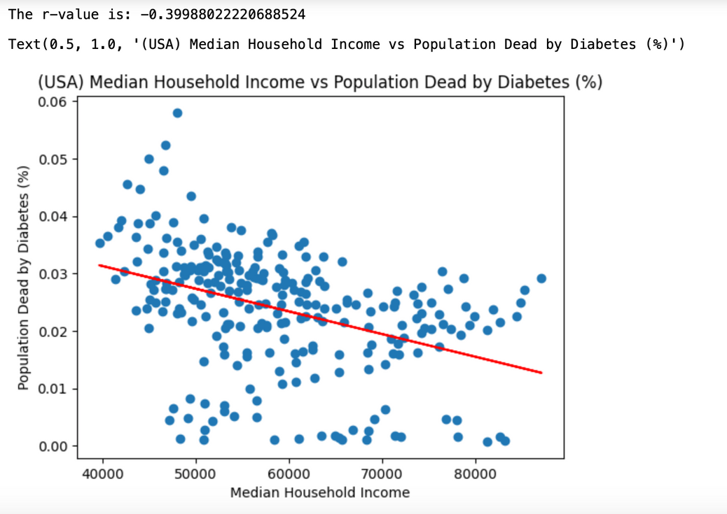
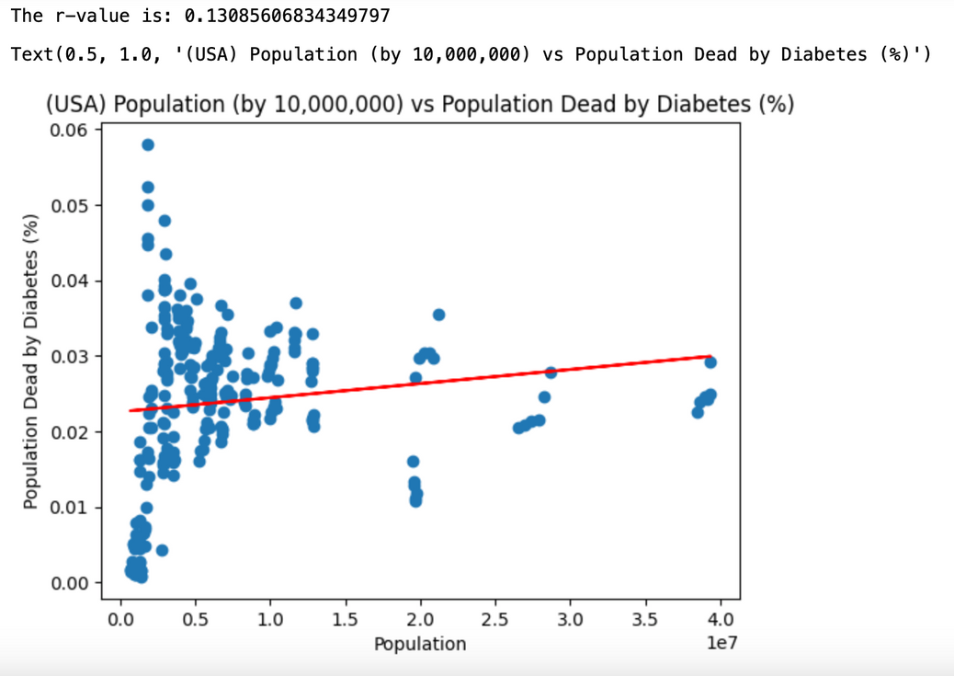
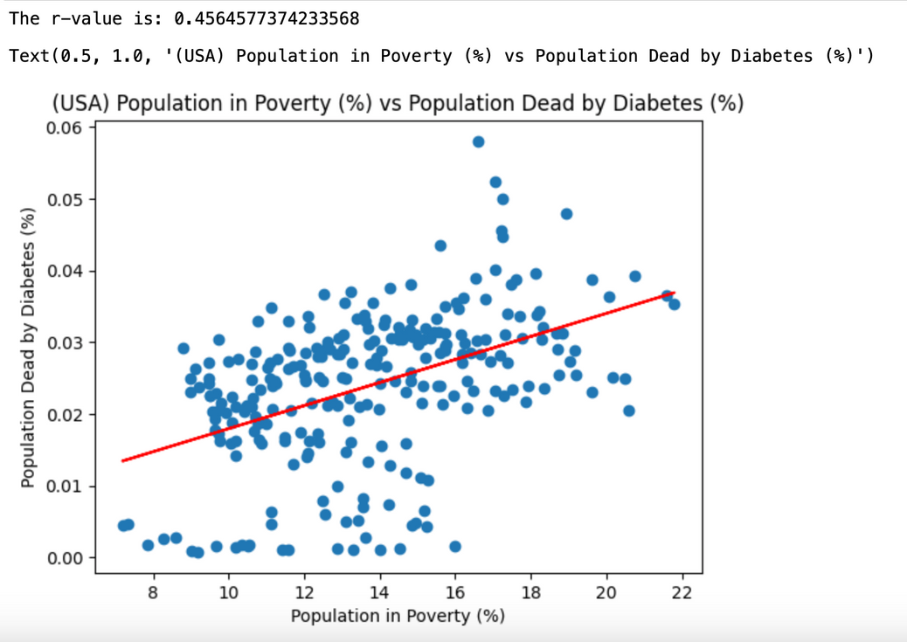
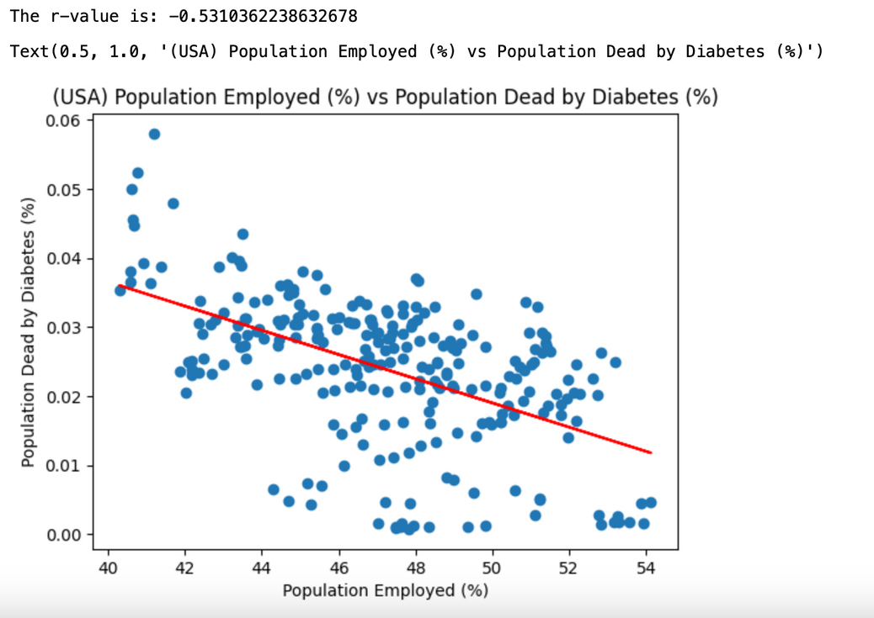
USA
removed Puerto Rico
correlations less strong
median household income and population employed have negative correlation

Slide 15

Deeper
Look

Slide 16

DeeperLook

Slide 17
Results
Is California an outlier?
California differs from the average state in terms of population and median household income
Are diabetes deaths correlated with poverty/GDP/population, employment?
We get different results based on what data we look at. In all cases there is some level of correlation, but whether it is positver or negative changes.

Slide 18


https://fred.stlouisfed.org/series/WPU06380103
https://ourworldindata.org/grapher/diabetes-prevalence-vs-gdp-per-capita
https://data.ca.gov/dataset/adults-with-diabetes-per-100-lghc-indicator
https://catalog.data.gov/dataset/weekly-counts-of-death-by-jurisdiction-and-cause-of-death
https://github.com/datamade/census
https://dof.ca.gov/reports/demographic-reports/american-community-survey/#ACS2018x1
Resource
PAGE

